Slide 1
Wireless and Mobile Network Architecture: Introduction

Slide 2
Coverage of Topic
PCS System
Type of PCS System
Some Definition
PCS System Classification
Mobility
Handoff

Slide 3
What is PCS
Personal Communication Services

Slide 4
What is PCS
Personal Communication Services
  A wide variety of network services that includes wireless access and personal mobility services
  Provided through a small terminal
  Enables communication at any time, at any place, and in any form.
The market for such services is tremendously big
  Think of cell-phone market

Slide 5
Several PCS systems
High-tier Systems
  GSM: Global System for Mobile Communications
    The mobile telephony system that we are using
  IS-136
    USA digital cellular mobile telephony system
    TDMA based multiple access
  Personal Digital Cellular
  IS-95 (Interim Standard) cdmaOne System
    CDMA based multiple access

Slide 6
Several PCS systems
Low-tier systems
  Residential, business and public cordless access applications and systems
    Cordless Telephone 2 (CT2)
    Digital Enhanced Cordless Telephone (DECT)
    Personal Access Communication Systems (PACS)
    Personal Handy Telephone System (PHS)

Slide 7
Several PCS systems
Wideband wireless systems
  For Internet access and multimedia transfer
    Cdma2000
    W-CDMA, proposed by Europe
    SCDMA, proposed by Chine/Europe

Slide 8
Several PCS systems
Other PCS Systems
  Special data systems
    CDPD: Cellular Digital Packet Data
    RAM Mobile Data
    Advanced Radio Data Information System (ARDIS)
  Paging Systems
  Mobile Satellite Systems
    LEO, MEO, HEO satellites for data/voice
  ISM band systems: Bluetooth, 802.11, etc.

Slide 9
PCS Problems
How to integrate mobile and wireless users to the Public Switched Telephone Network (PSTN) (Voice Network)
    Cellular mobile telephony system
How to integrate mobile and wireless users to the Internet (Data Network)
    Mobile IP, DHCP, Cellular IP
How to integrate all of them together and also add multimedia services (3G Systems)

Slide 10
Looking to PCS from different Angles
PSTN
(Telephone Network)
Internet
Wireless Access
Mobile Users
Laptop users
Pocket PC users
Mobile IP, DHCP enabled
computers
Mobile Users
Cell phone users
Cordless phone users
Telecom People View
Data Networking People View

Slide 11
Very Basic Cellular/PCS Architecture
Mobility
Database
Public Switched
Telephone Network
Base Station
Controller
Mobile
Switching
Center
(MSC)
Radio Network
Base Station
(BS)
Mobile Station

Slide 12
Wireless System Definitions
  Mobile Station
      A station in the cellular radio service intended for use while in motion at unspecified locations. They can be either hand-held personal units (portables) or installed on vehicles (mobiles)
  Base station
      A fixed station in a mobile radio system used for radio communication with the mobile stations. Base stations are located at the center or edge of a coverage region. They consists of radio channels and transmitter and receiver antennas mounted on top of a tower.

Slide 13
Wireless System Definitions
  Mobile Switching Center
      Switching center which coordinates the routing of calls in a large service area. In a cellular radio system, the MSC connections the cellular base stations and the mobiles to the PSTN (telephone network). It is also called Mobile Telephone Switching Office (MTSO)
  Subscriber
      A user who pays subscription charges for using a mobile communication system
  Transceiver
      A device capable of simultaneously transmitting and receiving radio signals

Slide 14
Wireless System Definitions
  Control Channel
      Radio channel used for transmission of call setup, call request, call initiation and other beacon and control purposes.
  Forward Channel
      Radio channel used for transmission of information from the base station to the mobile
  Reverse Channel
      Radio channel used for transmission of information from mobile to base station

Slide 15
Wireless System Definitions
  Simplex Systems
      Communication systems which provide only one-way communication
  Half Duplex Systems
      Communication Systems which allow two-way communication by using the same radio channel for both transmission and reception. At any given time, the user can either transmit or receive information.
  Full Duplex Systems
      Communication systems which allow simultaneous two-way communication. Transmission and reception is typically on two different channels (FDD).

Slide 16
Wireless System Definitions
  Handoff
      The process of transferring a mobile station from one channel or base station to an other.
  Roamer
      A mobile station which operates in a service area (market) other than that from which service has been subscribed.
  Page
      A brief message which is broadcast over the entire service area, usually in simulcast fashion by many base stations at the same time.

Slide 17
PCS Systems Classification
Cordless Telephones
Cellular Telephony (High-tier)
High Speed Local and Personal Area Networks
Paging Messaging Systems
Satellite Based Mobile Systems
3G/4G/5G Systems

Slide 18
Cordless Telephones
PSTN
Telephone
Network
Cordless
Phone
Base unit

Slide 19
Cordless Telephones
Characterized by
  Low mobility (in terms of range and speed)
  Low power consumption
  Two-way tetherless (wireless) voice communication
  High circuit quality
  Low cost equipment, small form factor and long talk-time
  No handoffs between base units
Appeared as analog devices
Digital devices appeared later with CT2, DECT standards in Europe and ISM band technologies in USA

Slide 20
Cordless Telephones
Usage
  At homes
  At public places where cordless phone base units are available
Design Choices
  Few users per MHz
  Few users per base unit
    Many base units are connected to only one handset
  Large number of base units per usage area
  Short transmission range

Slide 21
Cordless Phone
Some more features
  32 Kb/s adaptive differential pulse code modulation (ADPCM) digital speech encoding
  Tx power <= 10 mW
  Low-complexity radio signal processing
      No forward error correction (FEC).
  Low transmission delay < 50ms
  Simple Frequency Shift Modulation (FSK)
  Time Division Duplex (TDD)

Slide 22
Cellular Telephony
Characterized by
  High mobility provision
  Wide-range
  Two-way tetherless voice communication
  Handoff and roaming support
  Integrated with sophisticated public switched telephone network (PSTN)
  High transmit power requires at the handsets (~2W)

Slide 23
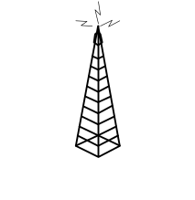
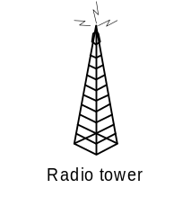

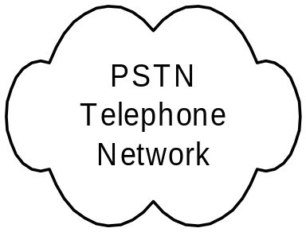
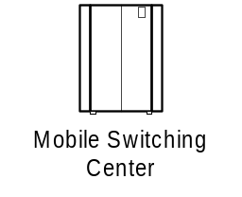
Cellular Telephony - Architecture

Slide 24
Cellular Telephony Systems
Mobile users and handsets
  Very complex circuitry and design
Base stations
  Provides gateway functionality between wireless and wireline links
  ~1 million dollar
Mobile switching centers
  Connect cellular system to the terrestrial telephone network

Slide 25
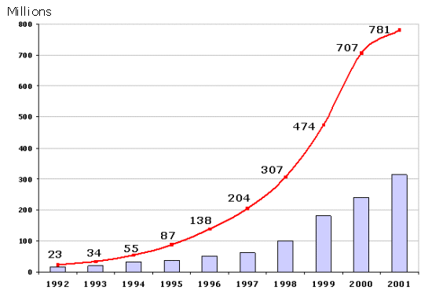
World Cellular Subscriber Growth

Slide 26
Cellular Networks
First Generation
    Analog Systems
    Analog Modulation, mostly FM
    AMPS
    Voice Traffic
    FDMA/FDD multiple access
Second Generation (2G)
    Digital Systems
    Digital Modulation
    Voice Traffic
    TDMA/FDD and CDMA/FDD multiple access
2.5G
    Digital Systems
    Voice + Low-datarate Data
Third Generation
    Digital
    Voice + High-datarate Data
    Multimedia Transmission also

Slide 27
2G Technologies
 | cdmaOne (IS-95) | GSM, DCS-1900 | IS-54/IS-136 PDC
Uplink Frequencies (MHz) | 824-849 (Cellular) 1850-1910 (US PCS) | 890-915 MHz (Eurpe) 1850-1910 (US PCS) | 800 MHz, 1500 Mhz (Japan) 1850-1910 (US PCS)
Downlink Frequencies | 869-894 MHz (US Cellular) 1930-1990 MHz (US PCS) | 935-960 (Europa) 1930-1990 (US PCS) | 869-894 MHz (Cellular) 1930-1990 (US PCS) 800 MHz, 1500 MHz (Japan)
Deplexing | FDD | FDD | FDD
Multiple Access | CDMA | TDMA | TDMA
Modulation | BPSK with Quadrature Spreading | GMSK with BT=0.3 | π/4 DQPSK
Carrier Seperation | 1.25 MHz | 200 KHz | 30 KHz (IS-136) (25 KHz PDC)
Channel Data Rate | 1.2288 Mchips/sec | 270.833 Kbps | 48.6 Kbps (IS-136) 42 Kbps (PDC)
Voice Channels per carrier | 64 | 8 | 3
Speech Coding | CELP at 13Kbps EVRC at 8Kbps | RPE-LTP at 13 Kbps | VSELP at 7.95 Kbps

Slide 28
2G and Data
2G is developed for voice communications
You can send data over 2G channels by using modem
Provides adat rates in the order of ~9.6 Kbps
Increased data rates are requires for internet application
This requires evolution towards new systems: 2.5 G

Slide 29
2.5 Technologies
Evolution of TDMA Systems
  HSCSD for 2.5G GSM
      Up to 57.6 Kbps data-rate
  GPRS for GSM and IS-136
      Up to 171.2 Kbps data-rate
  EDGE for 2.5G GSM and IS-136
      Up to 384 Kbps data-rate
Evolution of CDMA Systems
  IS-95B
      Up to 64 Kbps

Slide 30
3G Systems
Goals
  Voice and Data Transmission
    Simultanous voice and data access
  Multi-megabit Internet access
    Interactive web sessions
  Voice-activated calls
  Multimedia Content
    Live music

Slide 31
3G Systems
Evolution of Systems
    CDMA sysystem evaolved to CDMA2000
        CDMA2000-1xRTT: Upto 307 Kbps
        CDMA2000-1xEV:
        CDMA2000-1xEVDO: upto 2.4 Mbps
        CDMA2000-1xEVDV: 144 Kbps datarate
    GSM, IS-136 and PDC evolved to W-CDMA (Wideband CDMA) (also called UMTS)
        Up to 2.048 Mbps data-rates
        Future systems 8Mbps
        Expected to be fully deployed by 2010-2015
    New spectrum is allocated for these technologies

Slide 32
Upgrade Paths for 2G Technologies
2G
IS-95
GSM
IS-136
PDC
GPRS
2.5G
IS-95B
HSCSD
EDGE
3G
cdma200-1xRTT
W-CDMA
EDGE
cdma2000-1xEV,DV,DO
TD-SCDMA
cdma200-3xRTT

Slide 33
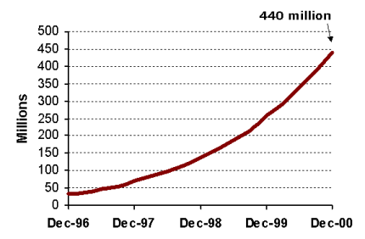
GSM Subscriber Growth

Slide 34
Chapter 2: Mobility Management

Slide 35
Introduction
In the PCS system architecture (Fig. 2.1), the mobile service area is covered by a set of BSs which are responsible for relaying the call to/from the MSs
The BSs are connected to MSCs by land links.
MSC interfaces the MSs (via BSs) with the PSTN

Slide 36
Cont.
Two types of databases are used for roaming management
  Home Location Register (HLR)
  Visitor Location Register (VLR)
Examples of the protocols to support mobility management
  EIA/TIA Interim Standard 41 (IS-41 or ANSI-41)
  GSM Mobile Application Part (MAP)

Slide 37
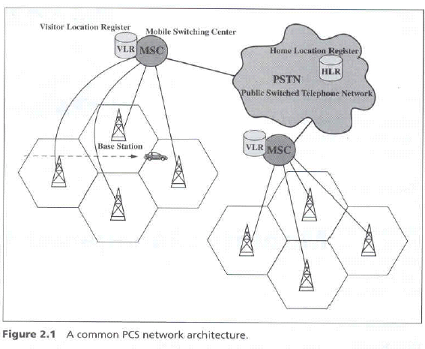
Fig. 2.1 A common PCS network architecture

Slide 38
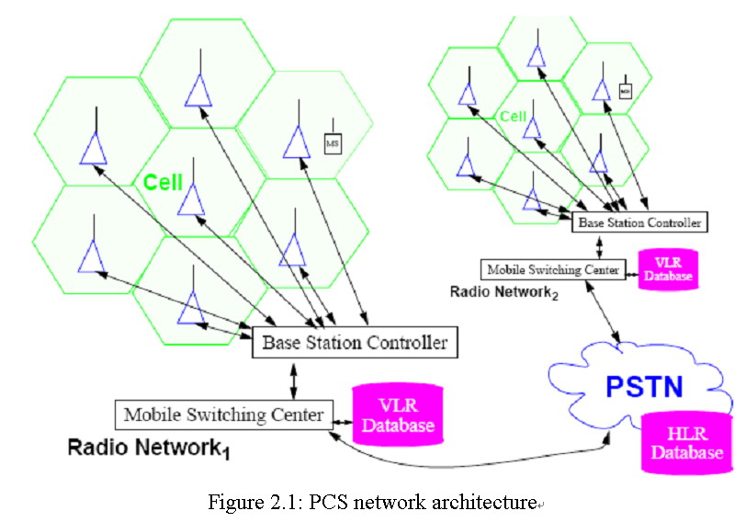
Fig. 2.1 A common PCS network architecture

Slide 39
Two Aspects of Mobility in a PCS Network
Handoff (link transfer, or handover)
  When a mobile user is engaged in conversion, the MS is connected to a BS via a radio link
  If the mobile user moves to the coverage area of another BS, the radio link to the old BS is disconnected, and a radio link to the new BS should be established to continue the conversation
Roaming
  When a mobile user moves from one PCS system to another, the system should be informed of the current location of the user

Slide 40
Three Strategies for Handoff Detection
Mobile-Controlled Handoff (MCHO)
  MCHO is used in DECT and PACS
  The MS continuously monitors the signal of the surrounding BSs,
  The MS initiates the handoff process when some handoff criteria are met.
Network-Controlled Handoff (NCHO)
  NCHO is used in CT-2 plus and AMPS
  The surrounding BSs measure the signal from the MS
  The network initiates the handoff process when some handoff criteria are met.

Slide 41
Cont.
Mobile-Assisted Handoff (MAHO)
  MAHO is used in GSM and IS-95
  The network asks the MS to measure the signal from the surrounding BSs,
  The network makes the handoff decision based on reports from the MS

Slide 42
Inter-BS Handoff
The new and old BSs are connected to the same MSC (Assumed that the need for handoff is detected by MS)
  The MS momentarily suspends conversation and initiates the handoff procedure by signaling on an idle channel in the new BS. Then it resumes the conversation on the old BS.
    Fig. 2.2(a)

Slide 43
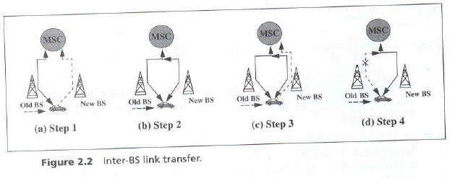
Fig. 2.2 Inter-BS link transfer

Slide 44
Cont.
  Upon receipt of the signal, the MSC transfers the encryption information to the selected idle channel of the new BS and sets up the new conversation path to the MS through that channel. The switch bridges the new path with the old path and informs the MS to transfer from the old channel to the new channel.
    Fig. 2.2(b)

Slide 45
Cont.
  After the MS has been transferred to the new BS. It signals the network, and resumes conversation using the new channel
    Fig. 2.2(c)
  Upon receipt of the handoff completion signal, the network removes the bridge from the path and releases resources associated with the old channel.
    Fig. 2.2(d)

Slide 46
For NCHO, all handoff signaling messages are exchanged between the MS and the old BS through the failing link. Thus, the whole process must be completed as quickly as possible.
If the new BS does not have an idle channel, the handoff call may be dropped (forced to terminate).
Forced termination of an ongoing call is considered less desirable than blocking a new call attempt.

Slide 47
Channel Assignment Schemes for Handoff Calls
Nonprioritized Scheme
  The networks handle a handoff in the same manner as a new call attempt
Reserved Channel Scheme
  Similar to the nonprioritized scheme, except that some channels in each BS are reserved for handoff calls

Slide 48
Queuing Priority Scheme
  Based on the fact that adjacent coverage areas of BSs overlap
  There is a considerable area where a call can be handled by either BS, which is called the handoff area
  If no new channel is available in the new BS during handoff, the new BS buffers the handoff request in a waiting queue.
  The MS continues to use the channel with the old BS until either a channel in the new BS becomes available

Slide 49
Subrating Scheme
  The new BS creates a new channel for a handoff call by sharing resources with an existing call if no free channel is available.
  Sub rating means an occupied full-rate channel is temporarily divided into two channels at half the original rate.
  One half-rate channel is to server the exiting call, and the other half-rate channel is to serve the handoff request
  When occupied channels are released, the sub rated channels are immediately switched back to the full rate channels.

Slide 50
2.1.2 Intersystem Handoff
Step 1
  MSC A requests a MSC B to perform handoff measurements on the call in progress.
  MSC then selects a candidate BS, BS2, and interrogates it for signal quality parameters.
  MSC B returns the signal quality parameters, along with other relevant information, to MSC A.

Slide 51
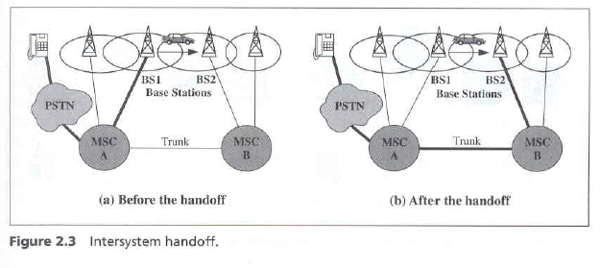
Fig. 2.3 Intersystem handoff

Slide 52
Step 2
  MSC A checks if the MS has made too many handoffs recently (e,g,, to avoid that MS is moving within overlapped area) or if intersystem trunks are not available.
  If so, MSC A exists the procedure
  Otherwise, MSC A asks MSC B to set up a voice channels.

Slide 53
Step 3
  MSC A sends the MS a handoff order
  The MS synchronizes to BS 2.
  After the MS is connected to BS 2, MSC B informs MSC A that the handoff is successful.
MSC A is referred to as the anchor MSC, and is always in the call path before and after the handoff.

Slide 54
Anchor Approach
If the MS moves back to MSC A again, the connection between MSC A and MSC B is removed.
If the MS moves to the third MSC C, the MSC B will be in the call path.
Path Minimization
  When the MS moves to the third MSC, the second MSC may be removed from the call path
  The link between MSC A and MSC B is disconnected, and MSC C is connected MSC A directly.

Slide 55
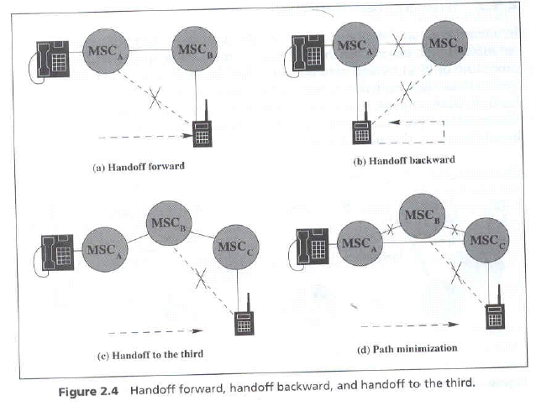
Fig. 2.4 Handoff forward, handoff backward, and handoff to the third

